Slide 1
Chapter 14 – Two Societies at War, 1861-1865
APUSH – Mr. Muller

Slide 2
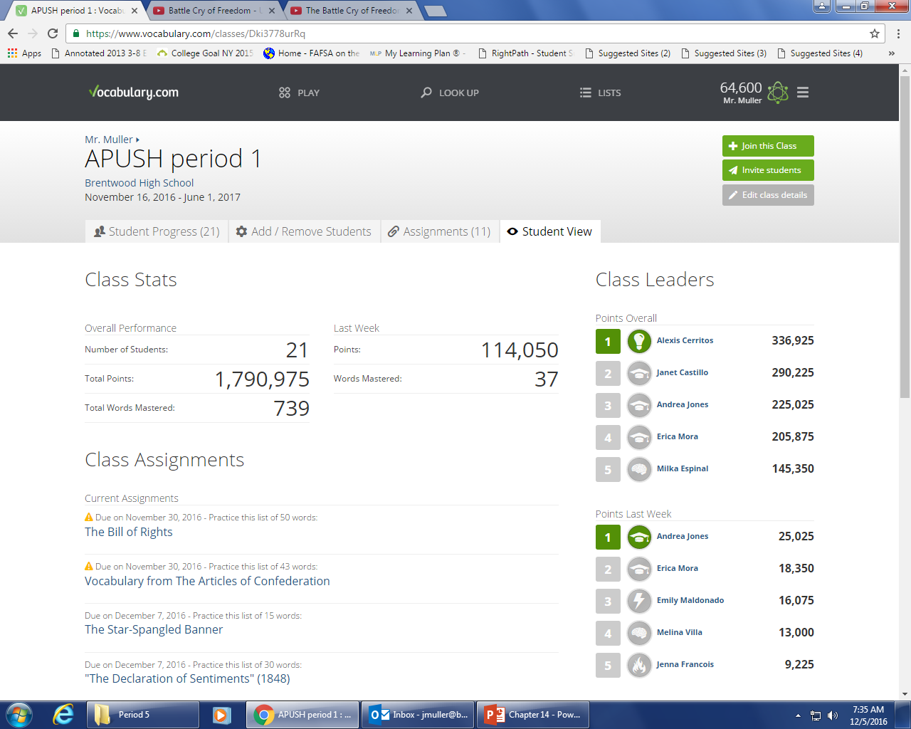

Slide 3
Do Now: Do Now: “It is enough to make the whole world start to see awful amount of death and destruction that now stalks abroad. Daily for the past two months has the work progressed and I see no signs of a remission till one or both the armies are destroyed… I begin to regard the death and mangling of a couple of thousand men as a small affair, a kind of morning dash-and it may be well that we become so hardened.” -General William T. Sherman, June 30, 1864
Aim: How does Civil War affect America?

Slide 4
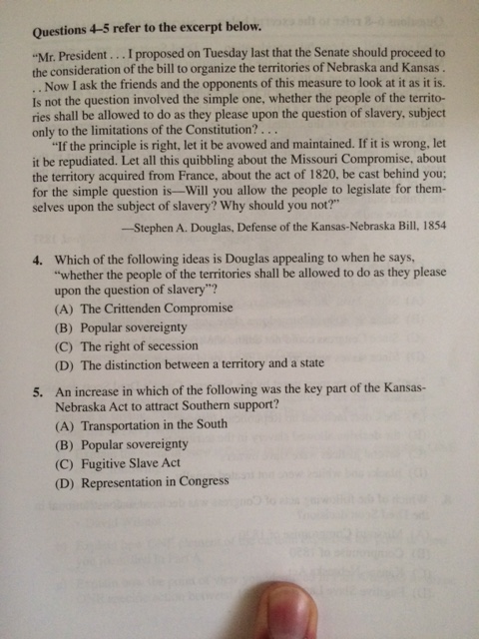

Slide 5
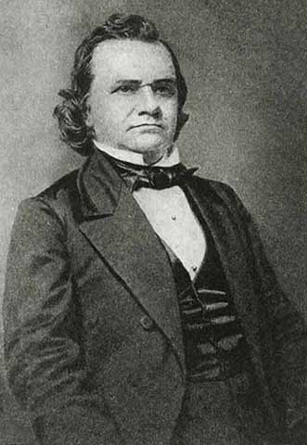
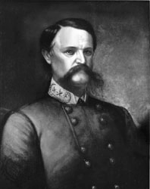
Election of 1860
Lincoln and the Republican party platform
For the free-soilers: no extension of slavery in territories
For the northern manufacturers: a protective tariff
For the Northwest: a Pacific railroad
For the farmers: free homesteads (land)
Southern secessionist threaten to leave Union if Lincoln wins
The issue of slavery had divided the Democrats
Northern Democrats favor Stephen Douglas
Popular sovereignty & enforce Fugitive Slave Act
Southern Democrats favor John C. Breckinridge
Allow slavery in the territories
Annex Cuba

Slide 6
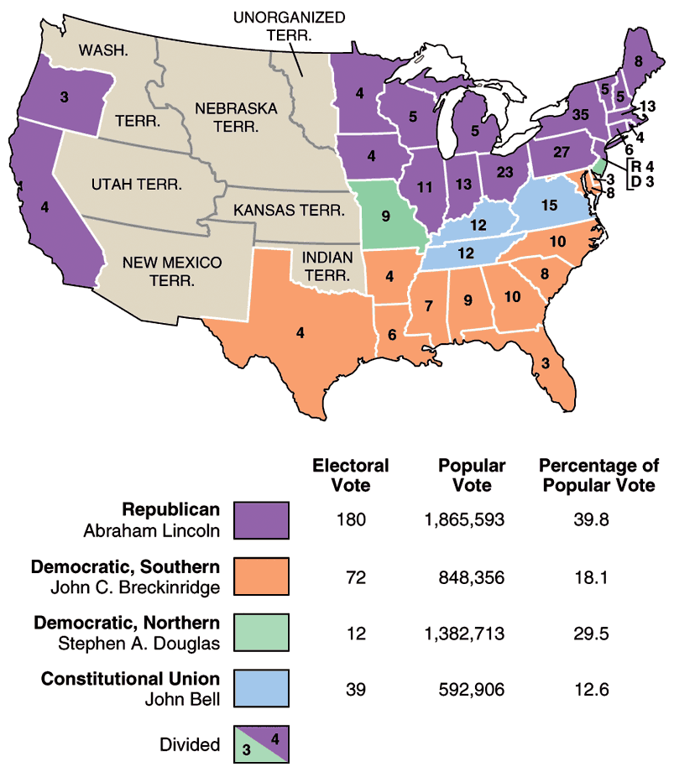
Results
Republican party wins the Presidency for the 1st time
But Lincoln is a “minority” President
Southerners see him as a sectional President
Not on ballot in 10 southern states

Slide 7
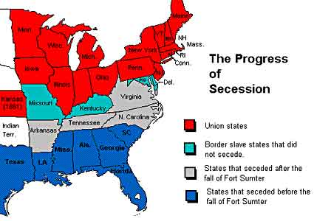
Secession!
South Carolina votes to secede in
December 1860
Eventually 7 southern states leave the union before Lincoln even takes office
See him as a sectional President hostile to slavery
Confederate States of America is formed
Jefferson Davis chosen as President
Lame Duck President Buchanan does nothing to stop secession
From November 1860 to March 1861
Does not believe secession is legal

Slide 8
Crittenden Compromise
Last gasp attempt to avoid a major crisis
Hope to calm southern fears:
The return of the Missouri Compromise idea
Slavery prohibited in territories north of 36°30′
Slavery allowed in territories south of 36°30′
Lincoln rejects this
Position of Republican party was no extension of slavery in the territories
Before Lincoln even takes office 7 southern states have left the union!

Slide 9
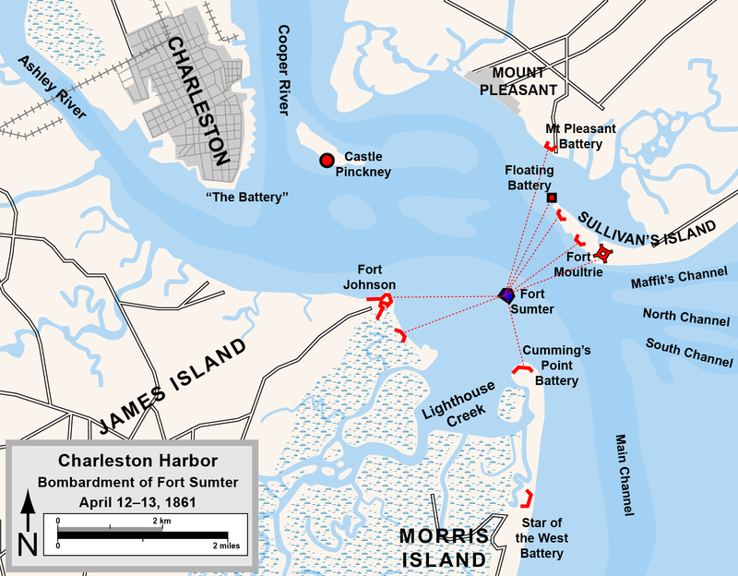
FORT SUMTER: WAR STARTS
7 southern states had already left the Union before Lincoln took office in March 1861
Lincoln’s Inaugural Address: pledged NOT to interfere with slavery
No right of secession
Lincoln says sending
provisions to Fort Sumter
Not reinforcements
Confederacy attacks Fort
Sumter in April 1861
Civil War begins!

Slide 10
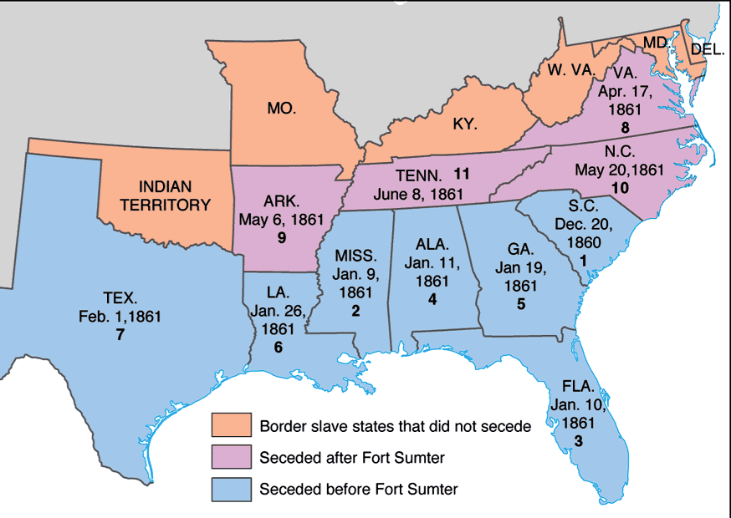
Impact
Unites the North against the South to preserve the Union
Lincoln calls for volunteers to fight
Southerners rally around the Confederacy (4 more states join the Confederacy)
Lincoln’s priority becomes keeping the Border States in the Union

Slide 11
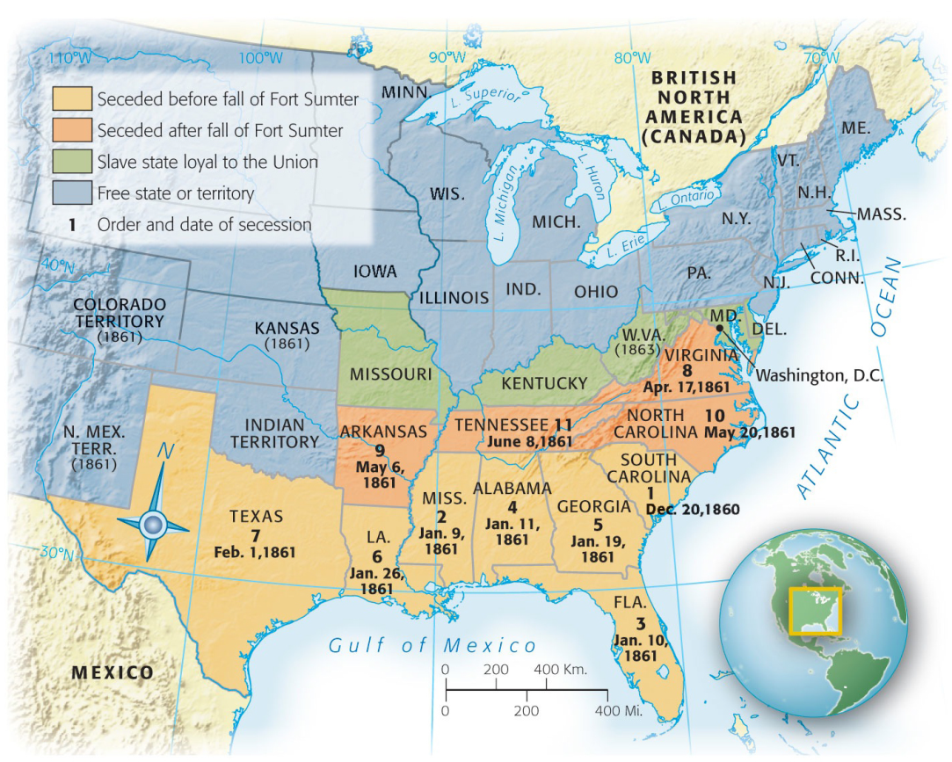
Border States
BORDER STATES :Missouri,
Kentucky, Delaware, and
Maryland
Slave states that remain in
the Union
Goal of Lincoln to keep them in the Union
Importance:
Would have given south more white men to fight
Would nearly double the manufacturing capacity of the South
Strategic geographic location
1) Martial law in Maryland
2) Guerilla Warfare in Missouri
3) Suspension of the writ of habeas corpus

Slide 12
North: The Union
Advantages
Industrial Resources
Majority of manufacturing capacity
Transportation
Railroads advantage
Powerful Navy and established government
Population Advantage
22 million to 9 million
Emancipation
Disadvantages
Lack of leadership
Many top military leaders joined the south
Lack of purpose
Southern states felt they were struggling for their independence

Slide 13
South: Confederate States
Advantages
Fighting defensive war
Friendly population
Sense of purpose
Reason to fight: Southern honor
Veteran military officials
Cotton Diplomacy
Hoped would get recognition and financial assistance
Disadvantages
Had no Navy
No government structure
States rights!
Poorly equipped and no railroad system
Weak economy
No manufacturing

Slide 14
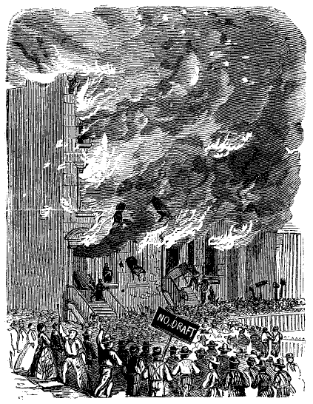
MOBILIZING FOR WAR: NORTH
Conscription Act: March 1863 all men 20-45 had to register for the draft.
Unfair to the poor: “Three-Hundred dollar men” substitutes
NY City Draft Riots: July 1863 mob of mostly Irish Americans attacked the wealthy and African Americans

Slide 15
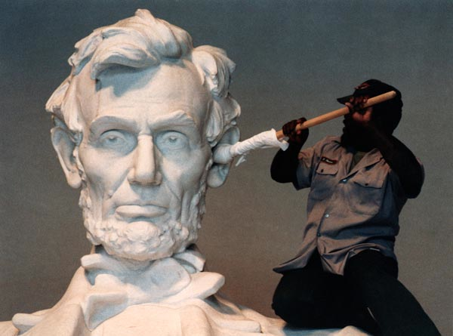
Lincoln →not fighting to end slavery
Secession was not legal
Needed to keep support from Border states
Fear from white workers in the north
Political concerns: Northern Democrats

Slide 16
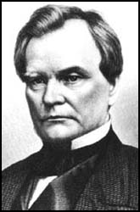
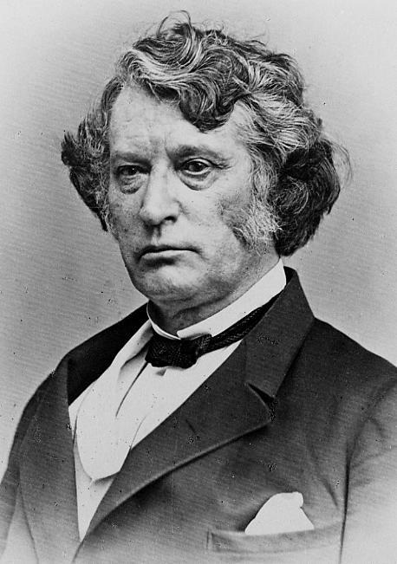
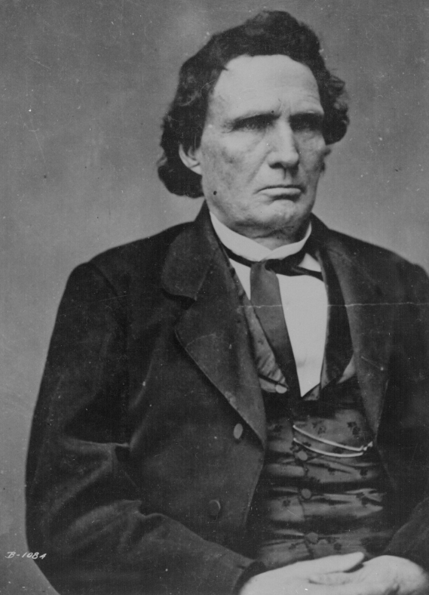
Emancipation
Two reasons to free the slaves
Military: liberate the slaves undermines the economic foundation of the south
Ideological: right thing to do, pressure to do so.
Radical Republicans had been pressuring Lincoln to make the war about slavery
Charles Sumner
Thaddeus Stevens
Benjamin Wade
Confiscation Act (Aug. 1861) slaves used for “insurrectionary purposes” declared free.
Incentive to escape to Union camps
2nd Confiscation Act (July 1862) freed all slaves who were enslaved by anybody engaged in rebellion against the U.S.

Slide 17
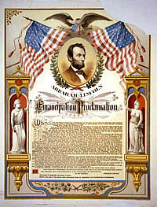
Emancipation Proclamation
Following the Battle of Antietam (Sept. 1862)
Lincoln decides to move forward with announcing emancipation.
Emancipation Proclamation was justified as military necessity
Declared slaves free in rebel territory (Confederacy)
DOES NOT FREE SLAVES IN THE BORDER STATES
Impact
Strengthened the moral cause of the North
Not just a war against secession- against slavery
Helped keep Europe from aiding Confederacy
Gave the Union new soldiers for Union army
Later → 13th Amendment (freedom)
Limits:
North had no authority in the Confederacy
Did not apply to border states

Slide 18
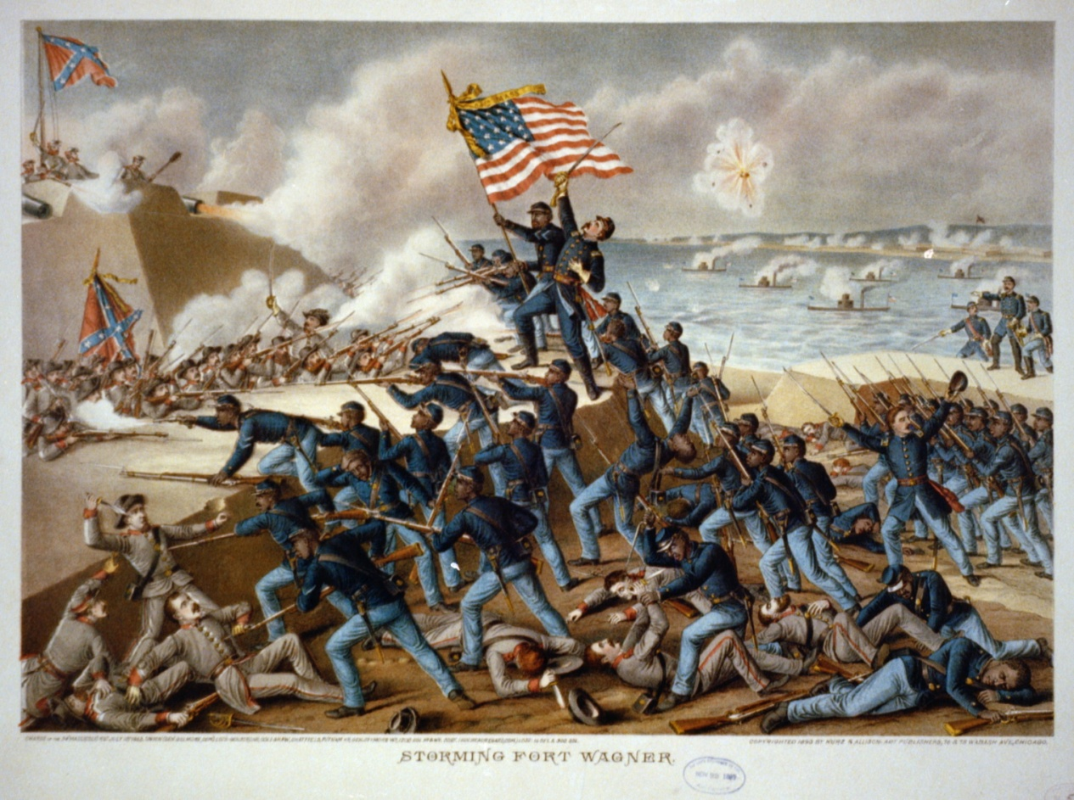
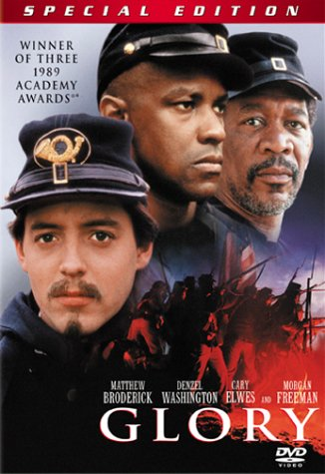
African Americans
Frederick Douglas saw enlistment in the Union army as an opportunity to prove their citizenship
Denied by Dred Scott
180,000 African Americans served in the war
Massachusetts 54th Regiment
Prejudice
Paid less than white soldiers

Slide 19
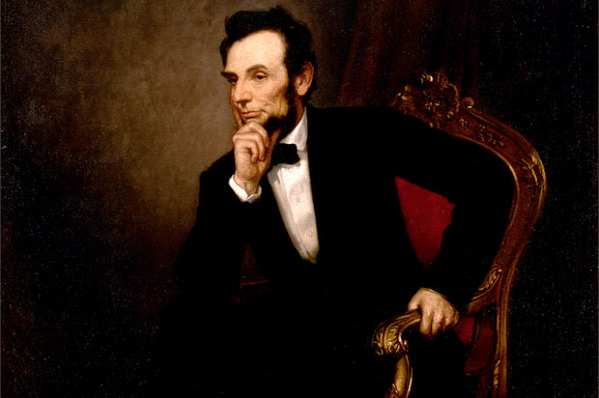
Executive Power
Civil liberties are oftentimes reduced during times of national crisis
Lincoln suspends the writ of habeas corpus in Maryland & other states
People arrested without being informed of the charges against them & held without trial
Presidential power oftentimes increases during times of war
Ordered a blockade without approval of Congress
Increase size of Federal Army without approval of Congress

Slide 20
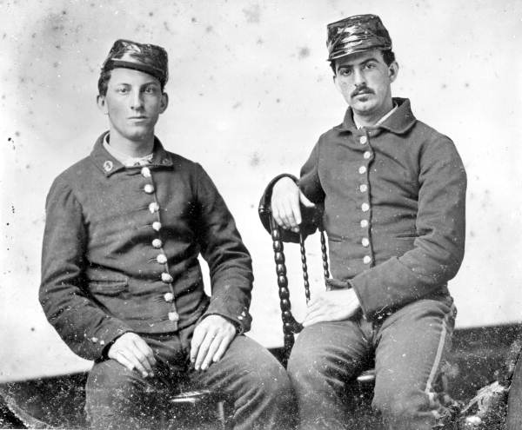
Politics
Challenges for Lincoln
Radical Republicans vs. Moderates
War Democrats: support war but criticized Lincoln’s handling of it.
Peace Democrats (Copperheads): opposed the war & wanted negotiated peace
Election of 1864
Lincoln beats General McClellan
Challenges for Confederacy
Cotton Diplomacy: Hope for European intervention
Europe obtained cotton from other sources
Failure at Antietam (Sept 1862)
Emancipation Proclamation in Jan 1863
Tradition of states rights makes fighting the war difficult
Conflict with central government

Slide 21
Republican majority in Congress
1861 – Morrill Tariff Act- help pay for war & protect northern industry
1862 – Homestead Act- set up sale of land in west and encourage settlement
1862 – Legal Tender Act- printing of paper money “greenbacks”
1863 – National Bank Act- financial landmark that sought to est. a unified banking system
1863 – Pacific Railway Act- est. northern route of transcontinental railroad

Slide 22
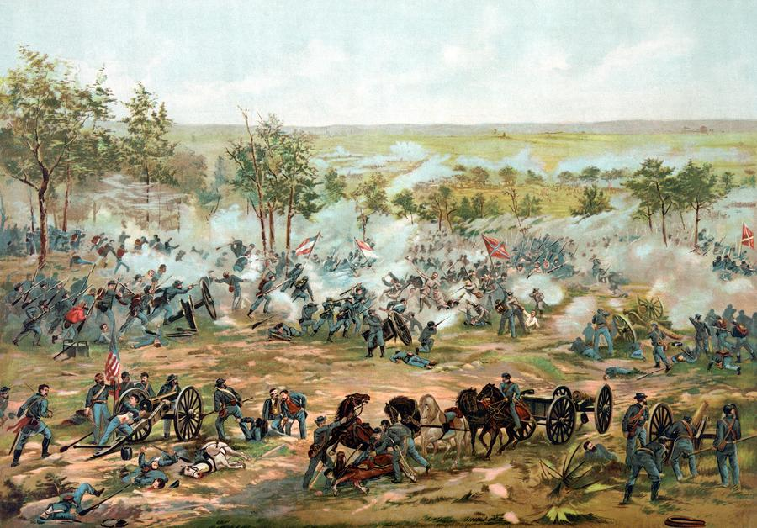
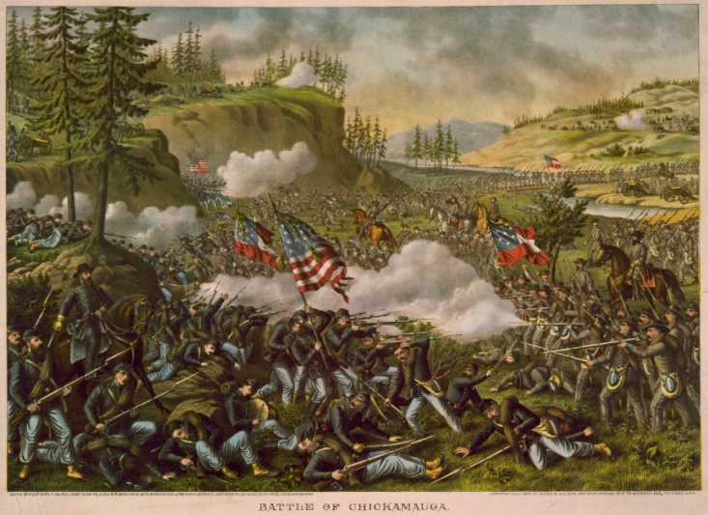
Impact of War
Over 600,000 lives lost
Southern economy destroyed and
northern industrialization accelerated by the war
Republican laws passed
Union preserved
Ideas of secession and nullification defeated
Civil War was ultimate test for American democracy
4 million slaves freed by the 13th
Amendment

Slide 23
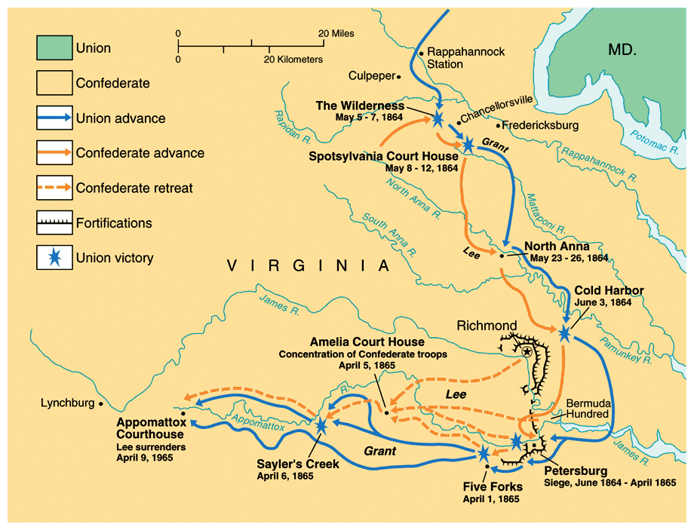
Surrender at Appomattox: April 9th 1865

Slide 24
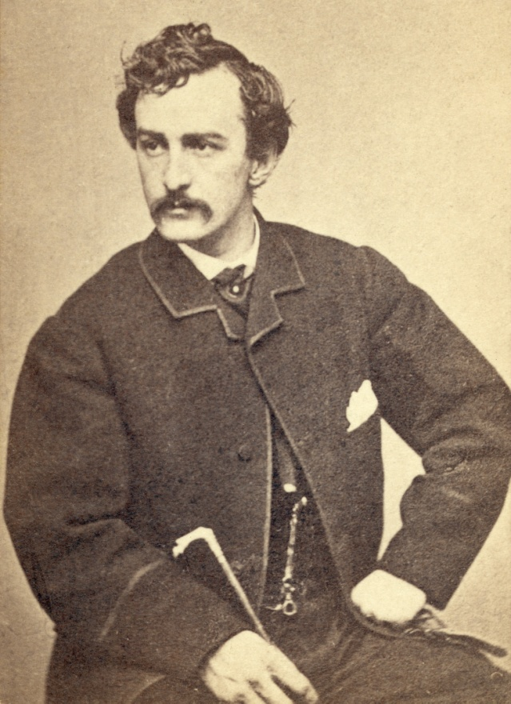
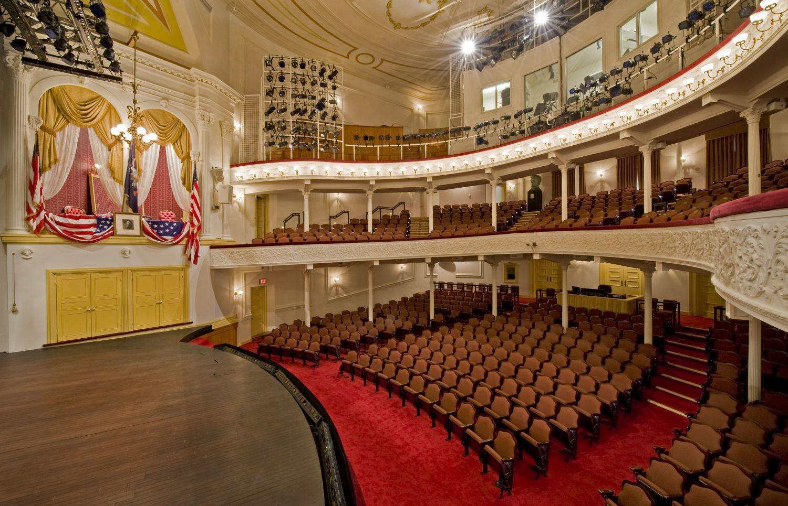
Lincoln
Lincoln is later assassinated after the war, by John Wilkes Booth at Ford’s Theater.

Slide 25
